Slide 1
Virus and Central Dogma

Slide 2
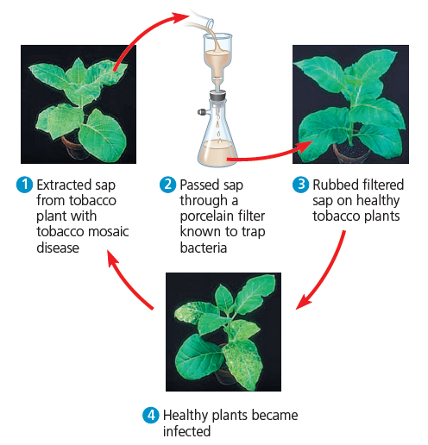
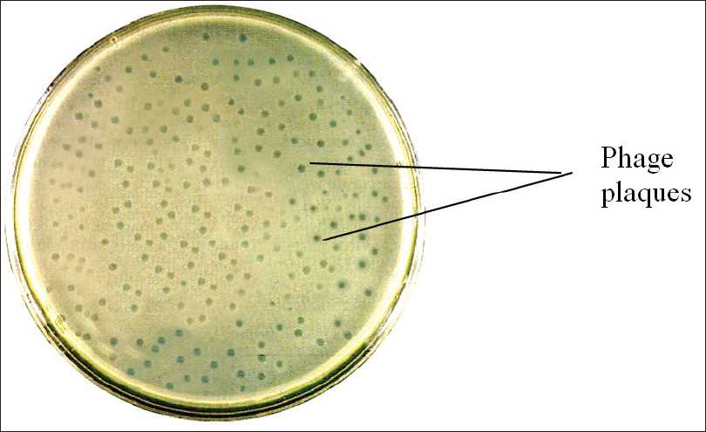
Detection methods for viruses
Visual detection – plaque formation
Polymerase chain reaction (PCR)
PCR or RT-PCR

Slide 3
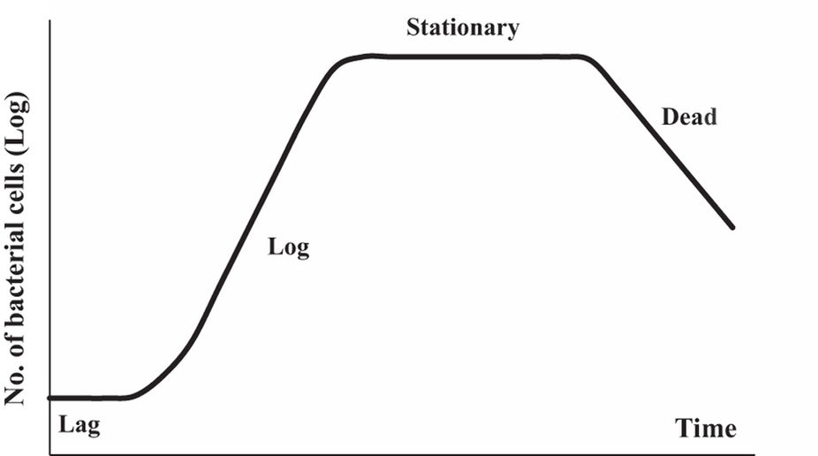
Virus growth
Bacterial growth
Virus growth
Lag phase
Log phase
Stationary phase
Dead
The eclipse period is the period during which no intracellular infectious virus can be recovered
The burst size is the average yield of infectious virus per cell
Burst size = final virus titre / initial virus titre

Slide 4
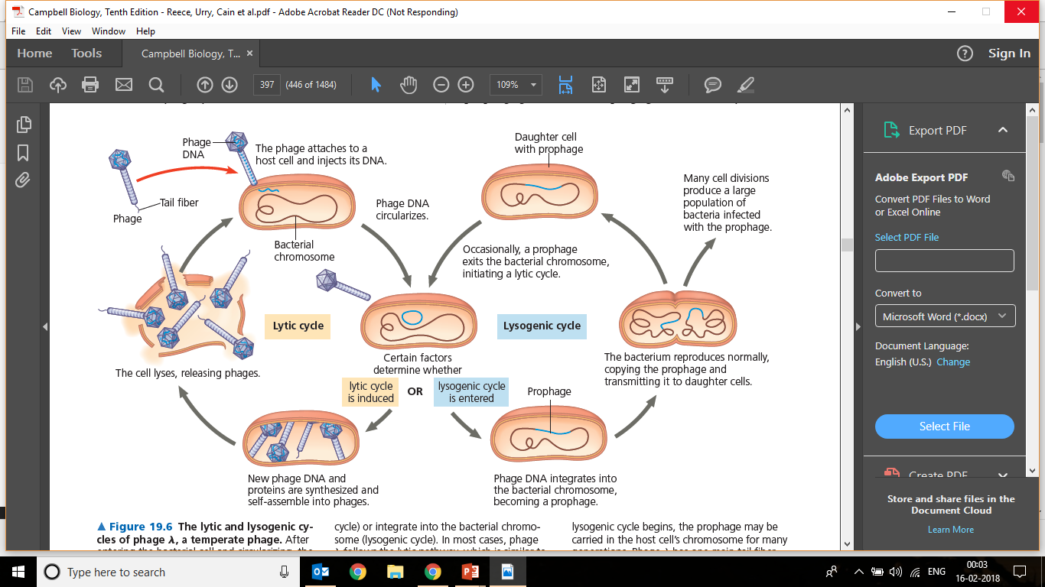
Viral Replication: Lytic vs Lysogenic
How to detect lytic and lysogenic cycle?
Lytic
Add bacteriophage
Add bacteriophage
Lysogenic
Clear broth indicates that bacteria (turbidity) have been killed
Hazy broth indicates that bacteria (turbidity) are still alive and bacteriophage has entered lysogeny
Broth inoculated with bacteria (turbidity)

Slide 5
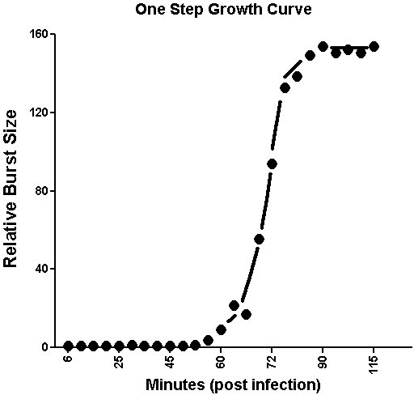
Problem
PFU/ml
How much is the latent period and burst size?
How much will be the burst size and latent period after second step?
How the graph will look during lysogeny?
52min and 160
Both will be same, but final viral titer will be 25600pfu/ml

Slide 6
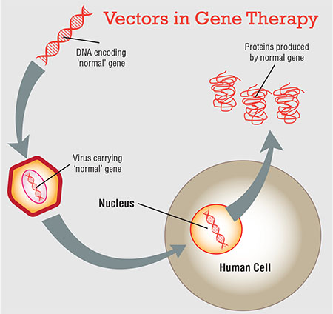
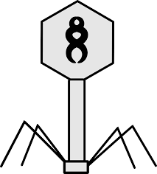
Application of viruses
Can you create a virus that carries DNA of your interest?
The coat proteins play important role in transfer of the DNA into host cell
However, DNA does not have any role in transfer. Certain parts of the viral DNA can be replaced with desired DNA
The amount of foreign DNA that can be introduced into the viral particle depends on the volume of the head
Gene therapy using recombinant viruses can be used to cure human genetic diseases
Viral particles enclosing a normal allele can be introduced in a person with defective allele for the same gene

Slide 7
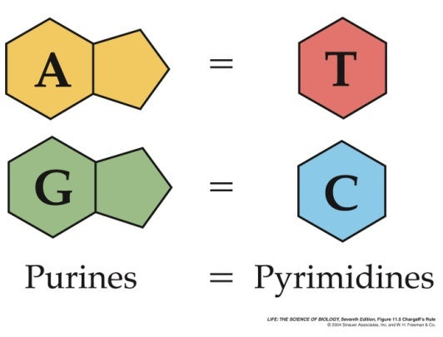
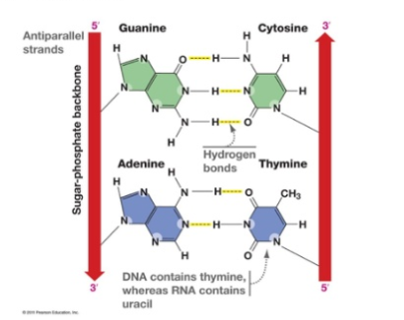
DNA Structure and Chargaff’s Rule
According to Chargaff’s rule [A]=[T] and [G]=[C].
Numerical: One strand of the Double stranded DNA contains 25% A, 30%T, 20% G. What is the nucleotide composition of the other strand.
Answer:
30% A, 25% T, 25%G ,20%C
What can you infer about the composition of DNA bases in the complementary strands???
Double stranded nucleotide sequence follow Chargaff’s rule because of base pairing pattern.

Slide 8
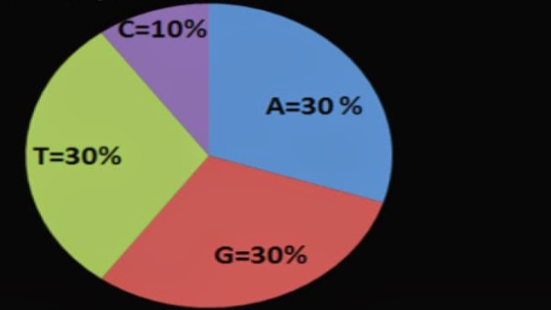
DNA Structure and Chargaff Rule
Ques1: A DNA sequencing Laboratory is involved in sequencing genome of different groups of organisms. Following is the result of the base composition of whole genome of a sample; What do you infer from this data?
Inference1:
As Thymine is present and not Uracil.
It’s a DNA and not RNA
Inference2:
As [A] ≠ [T]
[G] ≠ [C]
It doesn’t follow Chargaff’s Rule.
Answer: This is single stranded DNA virus genome.
Ques2: What can you predict about the AT/GC Content of thermophiles?
Ans: More of GC content.
Why???

Slide 9
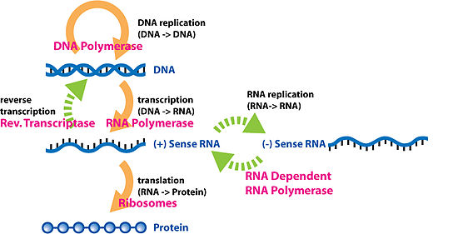
Central Dogma
Q. A) DNA (DNA to DNA) --> RNA --> Protein
B) RNA --> DNA --> protein,
C) RNA --> DNA --> protein,
Which of these are correct. Or arrange it in right order.
Ans. (A)

Slide 10
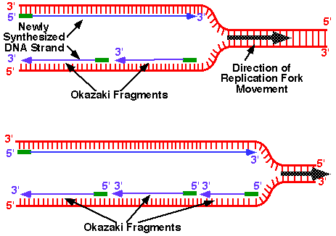
DNA Replication
Q1: During the replication of DNA, 2 new strands are synthesized using the 2 original strands as template. One of the strands is synthesized continuously. While the other is discontinuous. Why???
DNA polymerase can proceed only 5' to 3'.
Notes:
Because the lagging strand needs to be replicated in the opposite direction of the way the replication fork is proceeding. And DNA polymerase can proceed only 5' to 3'. Thus, short fragments are produced as the replication fork expands. Otherwise DNA polymerase would need to wait until the fork reached the end of the molecule to replicate the lagging strand. Nature found a beautiful solution with the Okazaki fragments that are joined by ligation.

Slide 11
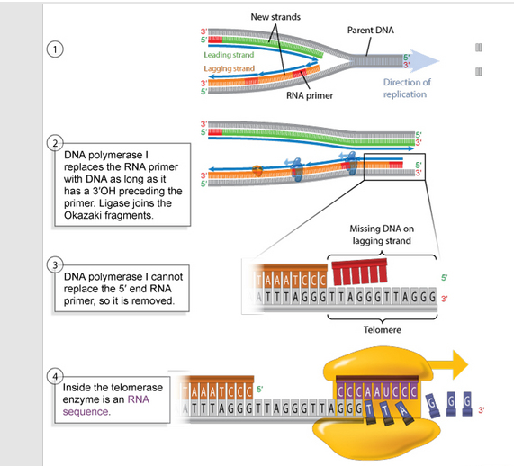
How to replicate the ends of DNA in lagging strand?
Telomeres replication

Slide 12
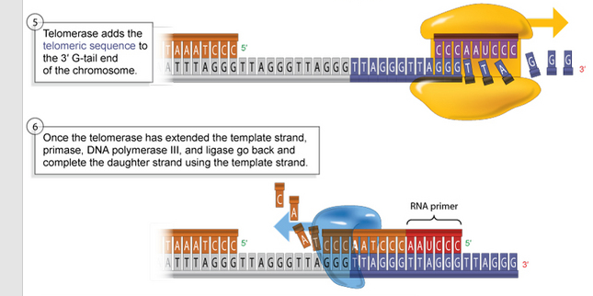
How to replicate the ends of DNA in lagging strand?
Ques: What will happen if there telomeres are not synthesized?
Chromosome will be shortened by about 25-200 bases (A, C, G, or T) per replication.
IMPLICATION????

Slide 13
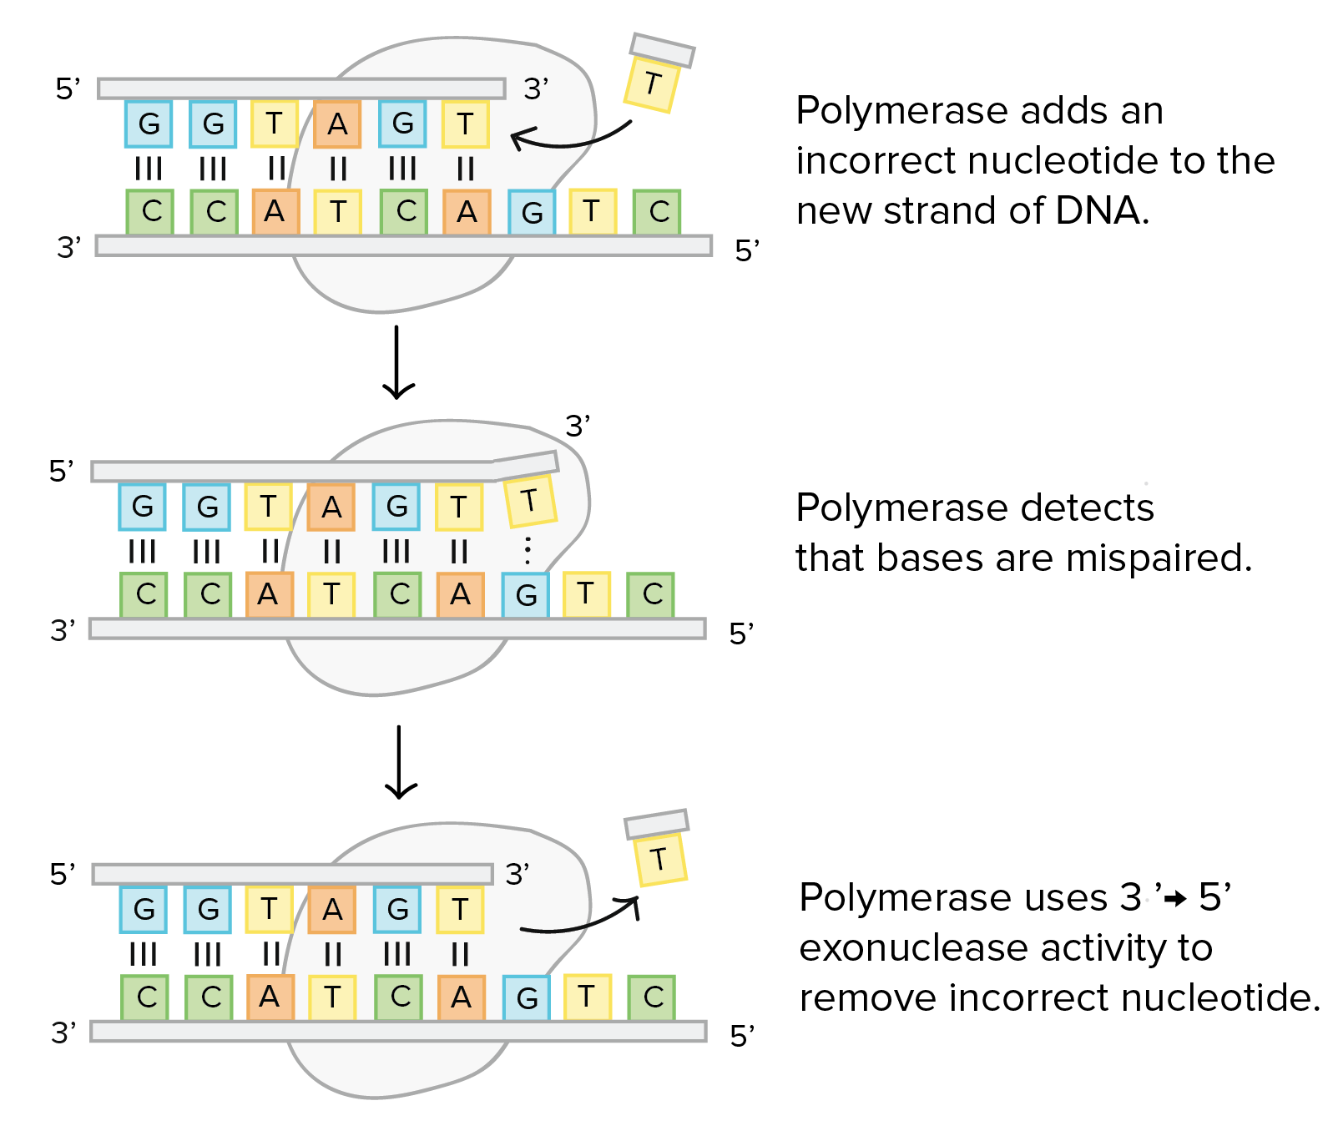
Proof Reading Activity
Why PCR products are required to be sequenced?

Slide 14
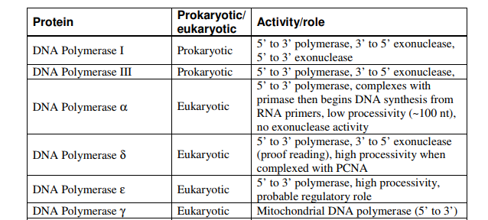
DNA Polymerase
DNA Polymerase: It is an enzyme that catalyze template-directed
DNA synthesis.
Proof reading activity: It allows the enzyme to check each nucleotide during DNA synthesis and excise mismatched nucleotides in the 3´ to 5´ direction.

Slide 15

Helicase and Topoisomerase
Helicase: An enzyme that unwinds the double helix by breaking the hydrogen bonds between the adjacent bases.
Topoisomerase: An enzyme that participates in the over-winding or under-winding of DNA.

